Slide 1
2026 Final Project

Slide 2
Project Instructions: Overview
3-5 people per group. In DingTalk group.
Each student must engage in substantive work(excluding making ppt or report), and please clearly state your contributions in the presentation and report.
Scores | Project1-4 | ProjectX
Evaluation | 2 | 0
Presentation | 8 | 10
Report | 2 | 2
Allow and encourage the use of AI to assist in completing major assignments, but it is hoped that the content of AI can be internalized.
Everyone needs to answer the questions.
Time | Project1-4 | ProjectX
15th Week | Evaluation | \
16th Week | Pre and Answer
After Exam | Submit Reoprt
Pre and Answer: 5+5=10mins.
adjusted due to group numbers

Slide 3
Project Instructions: Evaluation
Quantitative Evaluation: 15th Week.
Except for Project X, all projects must submit test codes using traditional image processing methods (Modern methods not involving deep models are allowed) or simple machine learning approaches for quantitative evaluation. During the quantitative assessment phase, large-scale models such as deep learning models or external data are prohibited.
The TAs will provide demo test files for each project for quantitative evaluation.
However, apart from quantitative evaluations, you can also utilize any methods and resources to enhance your performance or show your thoughts and attempts. You can incorporate it in the presentation or report.

Slide 4
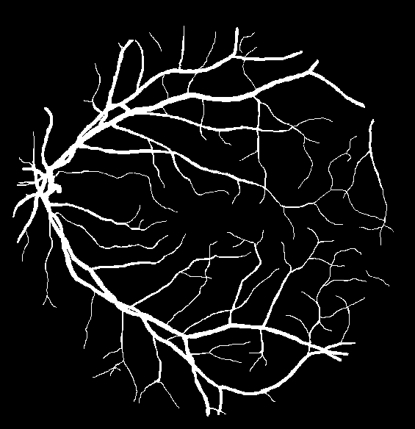
Project 1: Retinal Vessel Segmentation
Yingxi used a slightly damaged machine to collect some retinal images. Please help him segment the retinal vessels.
Data: 10 paired images
Evaluation: Dice
The test data also came from the same damaged instruments.

Slide 5
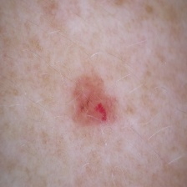
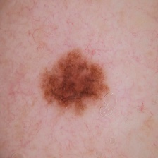
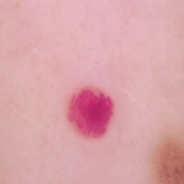
Project 2: Skin lesion classification
Extract image feature from skin lesion and use machine learning method to classify different lesions. The robustness of the algorithm needs to be demonstrated by the recognition of augmented images.
Data: 200 skin lesion images and another 400 augmented images
Evaluation: Classification results
The test data is also augmented from original data

Slide 6
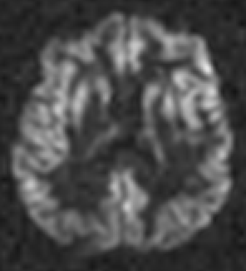
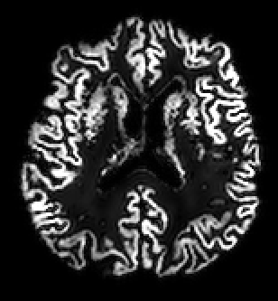
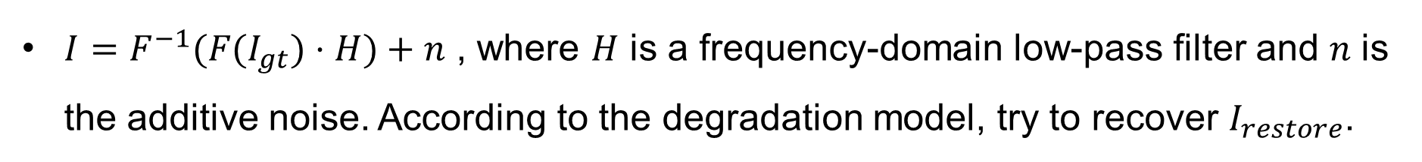
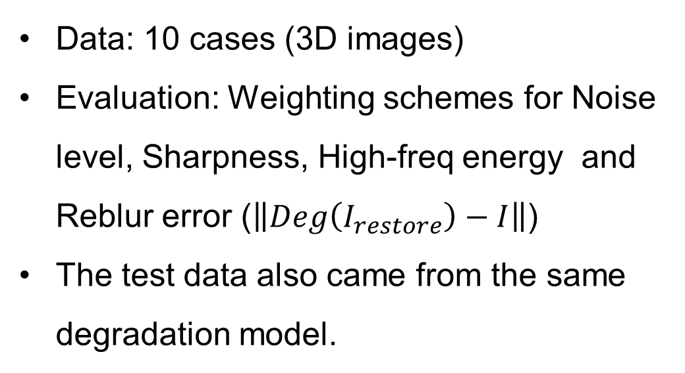
Project 3: ASL Image Restoration
$I=F^{−1}(F(I_{gt})⋅H)+n$ , where $H$ is a frequency‑domain low‑pass filter and 𝑛 is the additive noise. According to the degradation model, try to recover $I_{restore}$.
Data: 10 cases (3D images)
Evaluation: Weighting schemes for Noise level, Sharpness, High-freq energy and Reblur error ($\left\|Deg\left(I_{restore}\right)−I\right\|$)
The test data also came from the same degradation model.

Slide 7
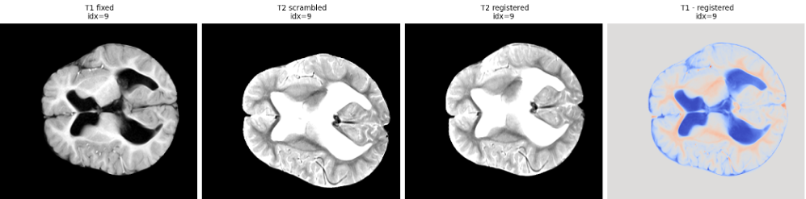
Project 4: Multimodal MRI Image Registration
Register the provided whole-head T2 MRI images to the skull-stripped T1 MRI images, with flexibility to design custom experimental protocols.
Data: 6 paired images (T1 and T2)
Evaluation: Weighting schemes for MI, NMI, Pearson and GradMagPearson
The test data is similar to the experimental data.

Slide 8
Project X
The quantitative evaluation scores will be integrated into the presentation.
Project X also requires the use of at least one traditional method (Modern methods not involving deep models are allowed) or simple machine learning.
Your project your way!
Freedom in choosing the project topics, but limited to biomedical image related projects.
Please discuss with teachers or the teaching assistants about your project design.

